Slide 1
Breaking the rules:
Innovation & Interaction in Leadership Development Programs
Michelle Baker | phase(two)learning
November 2013

Slide 2


Slide 3

Today’s agenda
Successful Leadership Development Programs
Innovation, Interaction and…
6+ Ideas to Energize a Leadership Development Program
Key Messages
Q&A; wrap-up

Slide 4

Small Group Discussion
“We want our leadership programs to have the reputation of being…”
Notes:
Let’s open things up with a brief discussion. In small groups, use your flip charts/markers to fill in the blanks and as many answers as you can come up with:
“We want our leadership programs to have the reputation of being…”
Time limit: 3 minutes (then discuss as group)
After discussion: It’s important to start with the end in mind. Not just with the metrics that you want to capture, or how you want to “move the needle”, but those QUALITATIVE measures that you can’t always put a number on. Balance the “head and the heart”. As we look at these traits and behaviors, it’s clear that this is what we want our programs to have.

Slide 5
Leadership development, defined.
Traditional “leadership development” refers to any activity that enhances the quality of leadership within an individual or organization.
These activities might include:
MBA programs
Team-building exercises
Executive retreats
Professional coaching
Workshops or seminars
Mentor programs
360-degree reviews/feedback
Source: Wikipedia
Notes:
Depending on your organization, traditional “leadership development” can have different meanings, can look differently, or be made up of very different activities. That’s okay! Just a few common activities in a traditional program might include these listed here…
Any other activities that might fall on this list?

Slide 6
Leadership development disconnect?
U.S. businesses spend more than $170 Billion per year on leadership-based curriculum…mostly on “Leadership Training”
You don’t always need to TRAIN leaders, but you do
need to DEVELOP them.
Training often focuses on “best” practices, but true leadership development focuses on “next” practices.
Source: ASTD
Source: forbes.com
Notes:
Clearly, U.S. businesses spend A LOT of money each year on leadership-based curriculum. Most of this is spent on TRAINING.
Is this simply a semantics issue? Are Leadership TRAINING and Leadership DEVELOPMENT really the same thing? How are they different?
In your handout, read the article excerpt. Take notes on your thoughts - we’ll discuss in 3 minutes.

Slide 7
Successful Leadership programs
Successful leadership development programs are often linked to 3 variables:
Learner Motivation
Program Quality
Manager Support
Source: Wikipedia
Notes:
Learner Motivation – Clearly, the leaders we are developing need to be engaged in the process. They need to commit to being developed, but they also need to own their own development.
Program Quality – As owners of the program, we need to ensure that the content is meaningful, relevant and engaging.
Manager Support – The direct supervisors of the learners need to be involved in the process, but upper-level managers and executives need to provide (and receive) feedback, as well as being “bought-in” to the program.
(If a successful program is linked to these 3 variables, would we be more likely to see its reputation meet the goals we discussed earlier?)

Slide 8

Keys to Success
Long-term plan & support
Blended learning approach
3. Relevant, measurable, level-specific offerings
4. Executive buy-in & involvement
5. Alignment to organizational vision, goals & strategy

Slide 9

Share your thoughts:
Get out your smartphone to text your response to this question:
What is the current state of your organization’s Leadership Development initiatives?

Slide 10
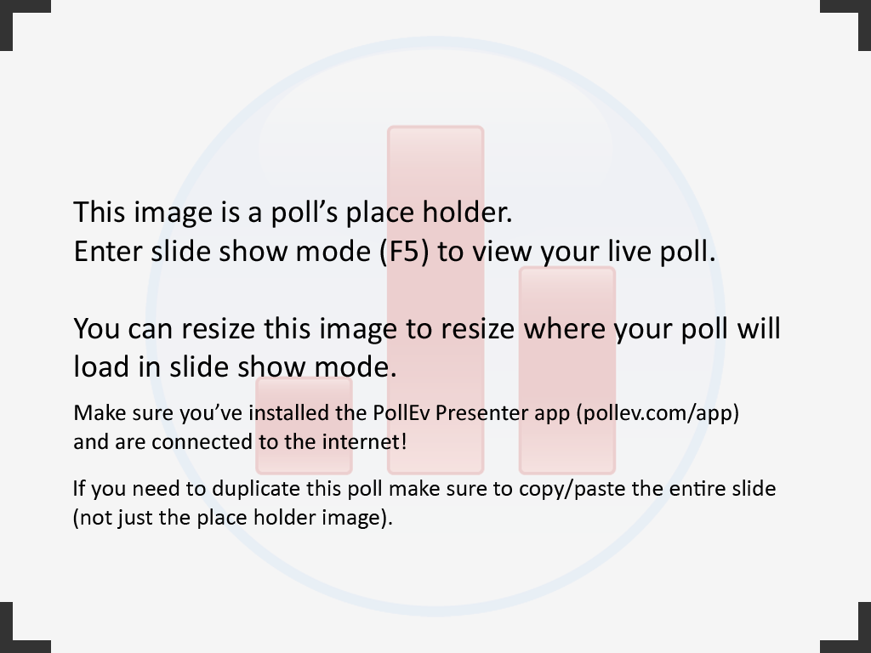
Notes:
Poll Title: What is the current state of your organization's Leadership Development initiatives?
http://www.polleverywhere.com/multiple_choice_polls/ZbqlfmCJfqWPpoS

Slide 11

So, what about
Breaking the rules?
Notes:
So, you might be wondering why the title of this session is about “breaking the rules”…
Like we discussed, depending on your organization, industry, workforce, and other situations, every leadership program is going to look different. And that’s okay. But even the most traditional leadership programs need to be energized once in awhile, right?

Slide 12

Leadership
Development
Doesn’t
Have to
Be
boring
Notes:
There is no rule that says “leadership development” has to be BORING!
Recently, I received these 2 binders from my boss’ boss. These were given to her by an employee who received this at his last job. This was PART of their leadership development program. I’m sure there is a lot of great content in this binder, but you know what I see?
Words. Lots and lots of words.
So, I approached this employee and asked him what he thought about the program.
He liked it, but…
It was boring. He said the sessions were mostly lecture-based, with some on-the-job projects thrown in. I asked him if he looked forward to attending the sessions…he didn’t. He said since it was “mandatory”, he went because it was required, and he wanted to be considered for future opportunities. But guess what? He’s not there anymore. That leadership development program didn’t keep him there.
What if we could ditch the binder and deliver similar topics in a more engaging way?

Slide 13

Innovation
Interaction
Imagination
Notes:
Three key words to keep in mind: Innovation – Interaction – Imagination.
Innovation – It’s okay to experiment, to try new things. In fact, it should be expected. There isn’t a rule that says a program has to be wordy slides in a binder.
Interaction – Get your people involved with one another. As teams, and cross-functionally. Building relationships is at the core of leadership.
Imagination – Be creative! Be progressive! Because…

Slide 14

Think
Progressively
To get leaders to act
progressively
Notes:
As we develop our programs, we need to be raising the bar on how to be INNOVATIVE, INTERACTIVE and IMAGINATIVE. We should be setting the example…because if we are thinking progressively, we can help encourage our learners to act progressively.

Slide 15

Six Ideas to
Encourage innovation
Increase interaction
Spark imagination
Notes:
I have 6 ideas for you now…ideas that you can easily implement into your existing programs. Use these ideas simply as a new way of delivering the same content. Maybe these will spark a new idea for you.
And, by the way…these methods aren’t limited to leadership development! Consider them for other Learning & Development initiatives as well!

Slide 16

LeaderFlix
Leadership Development Film Series
Open to all employees
Offered quarterly
Film themes aligns with leadership competencies
Notes:
Discuss FINL Leadership Performance Model:
8 Leadership Qualities (competencies)
2 highlighted each quarter of the year, with a theme
Required events for Hi-Po and Successors (blended/70-20-10)
Suggested events and offerings also available
LeaderFlix:
Open to all employees, once per quarter
Watch a familiar movie “with a new set of eyes” – look for the leadership themes, and discuss what we can take away and apply in our roles
This year = Hoosiers (coach, priority setter), Miracle (influencer, brand ambassador), Field of Dreams (strategic thinker, change agent), Rudy (player, achiever)

Slide 17

Leadership Happy Hour
Open to Director/VP level employees
Offered quarterly
Event held offsite
Guest speaker + internal discussion
Notes:
Leadership Happy Hour:
Backstory – This was the inspiration for the “breaking the rules” concept
Where is the rule that says we can’t get a group of people together and talk about leadership over a couple of drinks?
First session = Scott Wise (brand ambassador focus, keeping the customer at the core)
Second session = Pete the Planner (the importance of having mentors/being a mentor)

Slide 18

Speed dating
Open to all employees
Offered periodically
General topic communicated in advance, but discussion questions are shared at the event
Notes:
This is a great concept for mixing up people from different departments – breaking down silos – getting people to think outside of their daily roles, to see and appreciate similarities, differences and perspectives.
We have incorporated questions like “How can we be a resource for one another?” “How do we impact the customer experience?” “How might our teams work together in the future?” as well as standard questions on how we define our leadership qualities and how we can demonstrate those qualities in our roles.

Slide 19

Leadership Panel
Panel consists of VP/executive leaders
Audience – open to all employees
Offered quarterly
Panel questions pertain to leaders’ career paths, influencers, etc
Notes:
It was clear that our employees really want to hear from our leaders. They want to hear their stories, how their careers have evolved. How they define our leadership qualities. How they personally work to achieve their goals. What inspires them, and even what keeps them up at night. These sessions are OPTIONAL, and have been standing room only each time we have offered it.

Slide 20

Innovation groups
Open to all employees
Offered periodically
Assemble cross-functional “super-teams” to solve real-world business issues
Present solutions to executive teams or departmental sponsors
Notes:
This was inspired by our internship program. Our interns spend their summers in different departments across the organization, but are grouped into teams that are given a business challenge. Throughout the summer, they work on a solution to propose to our executives.
We thought, why is this something we only do with interns? If we assembled the collective brain power from across our organization – particularly with our high-potentials and successors – we could challenge them to build relationships, encourage innovative thinking, stimulate solutions to “real-world” issues, and help prepare those high-potential and successor candidates for their next steps in the organization.

Slide 21

Social media
Open to all employees
Ongoing discussion, networking and resource sharing
“Hang out where your people hang out”
Notes:
Wherever your people are, go there.
If everyone is on LinkedIn, start a group.
If your people are on Twitter, tweet about your program.
If Facebook is the thing, get them to “like” your page.
If you use Yammer, utilize that.
If your LMS has social capabilites, maybe that’s the avenue for you.
Keep the conversation going. Ask questions to the group to stimulate dialogue. Celebrate promotions, sales gains or goal achievement. Post pictures from your events. Share relevant articles and resources. Build a collaborative community of learning.

Slide 22
Small Group Discussion
How could you use your assigned method to develop leaders or facilitate learning?
(Brainstorm – use your flip chart to list)
Notes:
Implementing a Scavenger Hunt
Launching a Book Club
Soliciting user-generated content (blogs, YouTube/Vimeo/Vine videos, Instagram, etc)
Involvement in New Employee Onboarding Process

Slide 23
Keys to Success
Long-term plan & support
Blended learning approach
3. Relevant, measurable, level-specific offerings
4. Executive buy-in & involvement
5. Alignment to organizational vision, goals & strategy

Slide 24
Key messages
Leadership training & Leadership development are different
Successful programs have:
  Learner motivation
  Program quality
  Manager support
Progressive programs breed progressive leaders
Leadership development doesn’t have to be boring!

